Slide 1

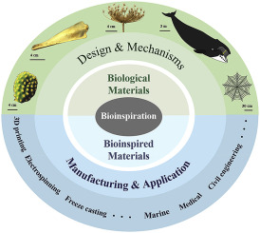
WORK BOOK !!!!!!!

Slide 2
QUIZ !!!
1. If an engineer knows biology, which of the following are valid statements?
a. The engineer can effectively contribute to engineering aspects of biological systems
b. The engineer can improve the understanding of biological information
c. The engineer will be shunned by his peers
d. The engineer will be apologetic about his position to his supervisors

Slide 3
QUIZ !!!
2. In the development of the artificial retina, which of the following engineers probably played a role?
a. Electrical engineers
b. Computer scientists
c. Biological engineers
d. Mechanical engineers

Slide 4
QUIZ !!!
3. Engineering students are comfortable with the four basic arithmetic operations because all engineering students:
a. Have a natural orientation toward mathematician engineer knows biology, which of the following are valid statements?
b. Have used the four basic arithmetic operations
c. The engineer will be shunned by his peers Know shortcuts to all four basic arithmetic operations
d. Are highly smart

Slide 5
QUIZ !!!
4. Which of the following statements are not valid for the field of physics:
a. Physicists made a lot of observations over the past few centuries
b. There are rules that govern physical phenomena
c. None of the rules that govern physical phenomena are universal
d. All physicists are scared of biology

Slide 6
QUIZ !!!
5. What are biosensors?
a. Devices to provide light
b. Devices that can provide heat energy
c. Devices that can measure relevant analyte concentrations
d. Devices that can measure relevant signals from the body

Slide 7
QUIZ !!!
6. What are bio-fertilizers made of ?
a. Microorganisms
b. Chemicals alone that can kill pests
c. Elements such as N, P, K, alone
d. Microorganisms that only kill pests

Slide 8
QUIZ !!!
7. Name the blood vessel that carries infiltrated blood from the aorta to the kidney ?
a. Coronary artery
b. Pulmonary artery
c. Renal artery
d. Renal vein

Slide 9
QUIZ !!!
8. Which of these act as a store house for fats?
a. Yellow bone marrow
b. Red bone marrow
c. Blood cells
d. Hematopoietic cells

Slide 10
QUIZ !!!
9. Which of these is a neurological disorder?
a. Psiatica
b. Alopacia
c. Alzehimer disease
d. Hashimoto Syndrome

Slide 11
QUIZ !!!
10. In a human, the left lung has two of these but the right lung has three. What are they?
a. Lobes
b. Pluera
c. Muscles
d. Fissures

Slide 12
QUIZ !!!
11. The period of contraction of ventricles of the heart is known as ?
a. Diastole
b. Systole
c. Cardiac cycle
d. Cardiac output

Slide 13
QUIZ !!!
12.What is then ame of the tissue that connects muscle to bone?
a. Cartilage
b. Tendon
c. Epithelial
d. Ligament

Slide 14
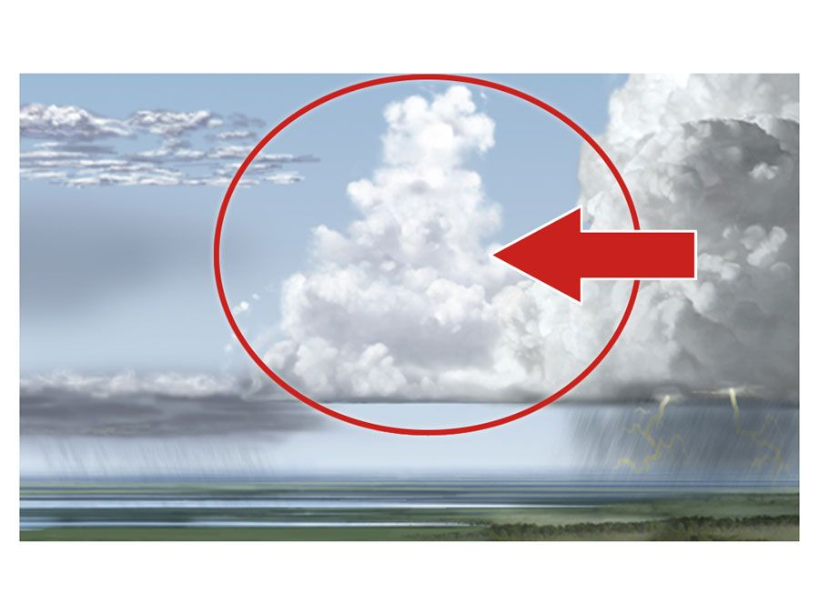
QUIZ !!!
13. Name that thing: in Nature ?
a. Stratocumulus cloud
b. Cumulus cloud
c. Cirrus cloud
d. Stratus cloud

Slide 15
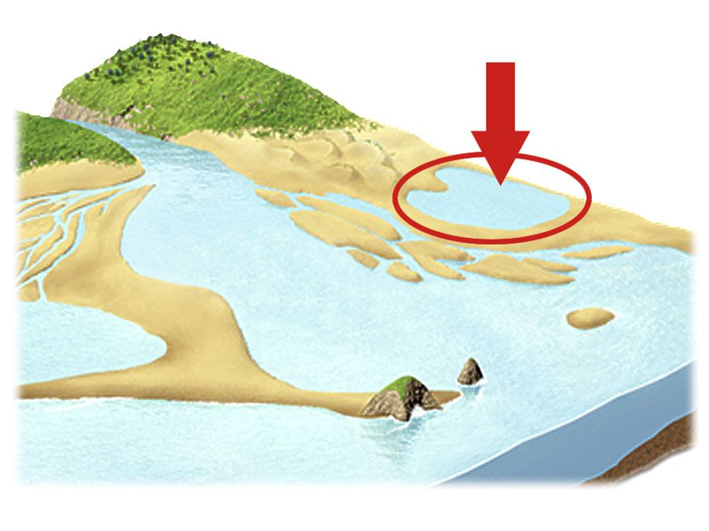
QUIZ !!!
14. Name that thing: in Nature ?
a. Delta
b. Estuary
c. Lagoon
d. Hedland

Slide 16
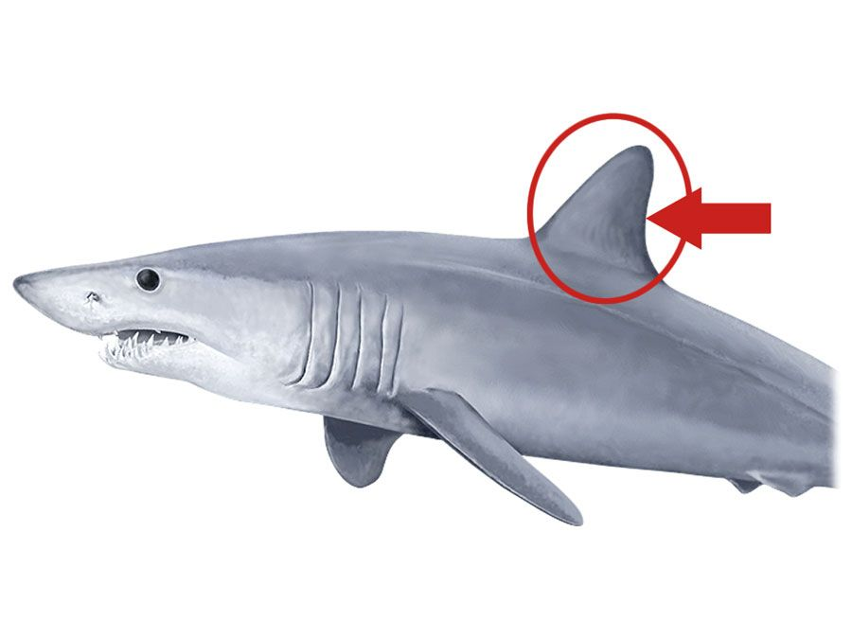
QUIZ !!!
15. Name that thing: in Nature ?
a. Caudal fin
b. Dorsal Fin
c. Pelvic fin
d. Pectoral Fin

Slide 17
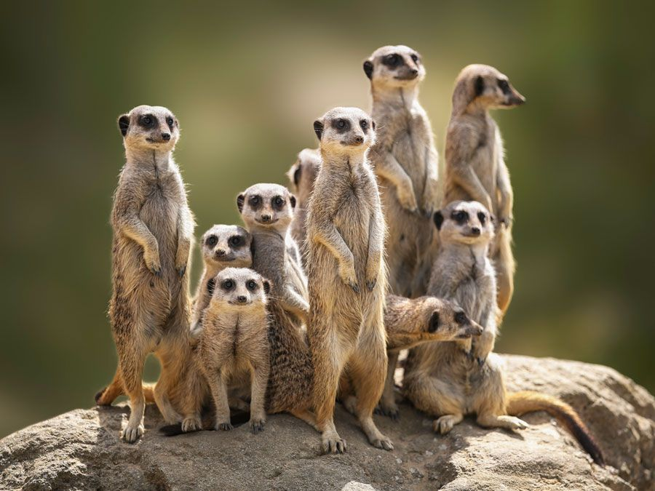
QUIZ !!!
16. Name that thing: in Nature ?
a. Bandiccots
b. Prarie dogs
c. Servals
d. Meerkats

Slide 18
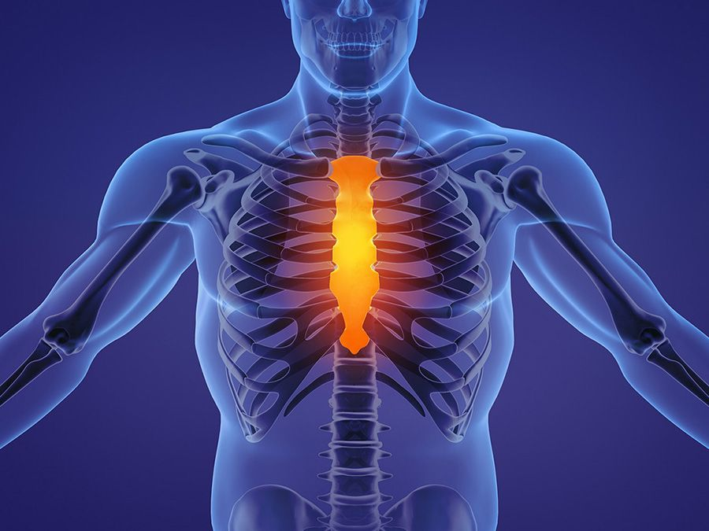
QUIZ !!!
17. Guess the bones/Muscles ?
a. Palatien
b. Scapula
c. Sternum
d. Trachea

Slide 19
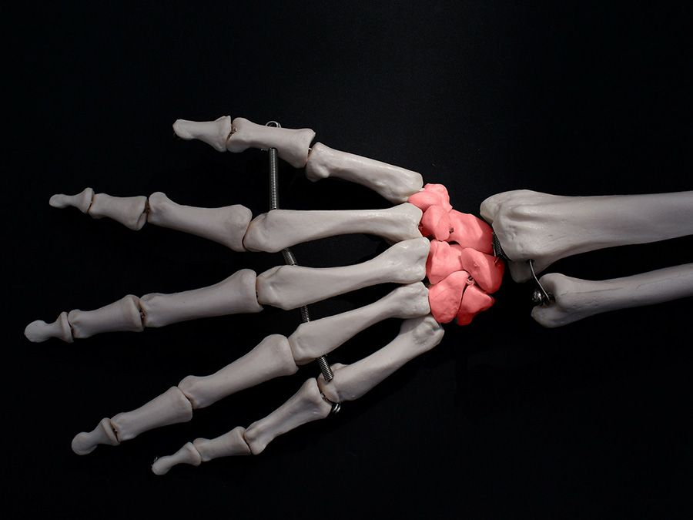
QUIZ !!!
18. Guess the bones/Muscles ?
a. Humeres
b. Carpal bones
c. Ulna
d. Radius

Slide 20
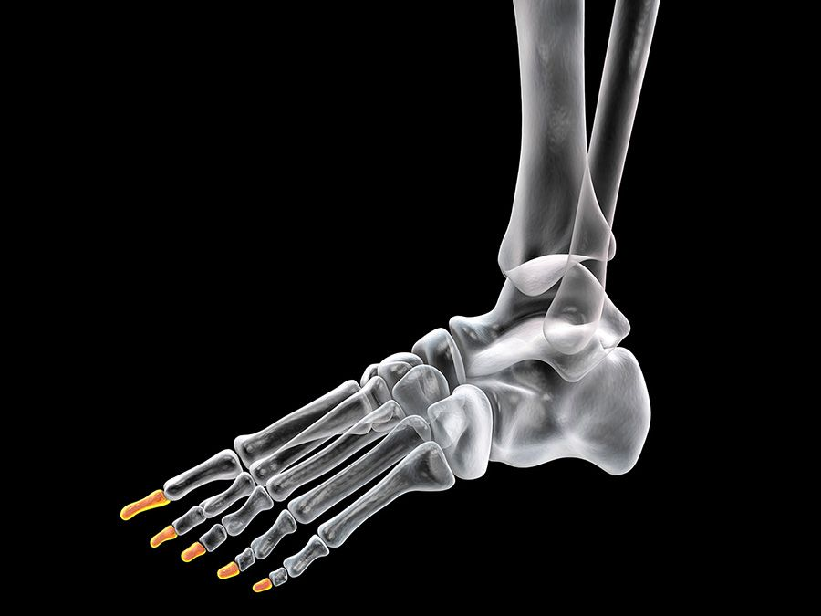
QUIZ !!!
19. Guess the bones/Muscles ?
a. HumeresMetacarpels
b. Ossicles
c. Sesamoids
d. Phalanges

Slide 21
QUIZ !!!
20. Which of the following are considered medical devices ?
a. Pacemakers
b. Medical thermometer
c. Tongue depressor
d. All the above

Slide 22
QUIZ !!!
21. Implantable devices like pacemakers deliver electrical impulses to heart muscle chambers to contract and pump blood. Bluetooth-enabled devices now provide access to device data through an app, rather than a bedside console. What is the biggest benefit ?
a. Increased patient engagement
b. Easier data transmission
c. Easier access to cardiac information
d. All the above

Slide 23
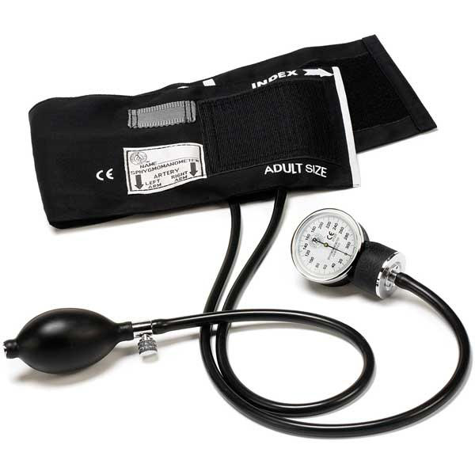
QUIZ !!!
22. Can you name the device?
a. Sphygmomanometer
b. Cardioverter
c. Opthalmometer
d. All the above

Slide 24
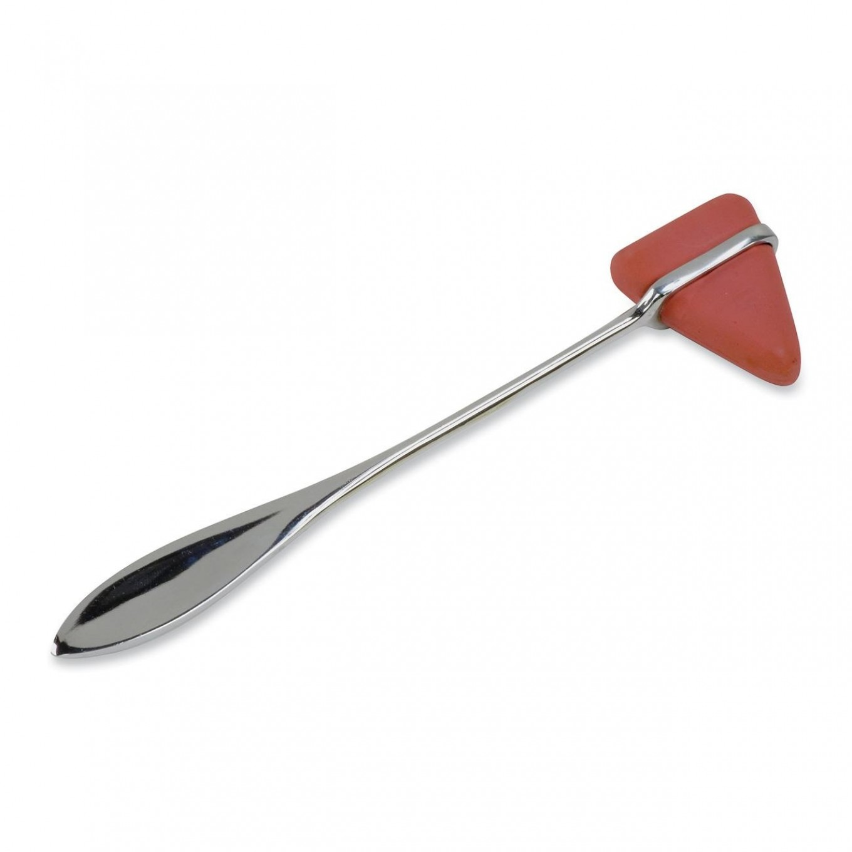
QUIZ !!!
23. Can you name the device?
a. Reflex triangle
b. Nerval sensitivity hammer
c. Reflex hammer
d. Bone sensitivity hammer

Slide 25
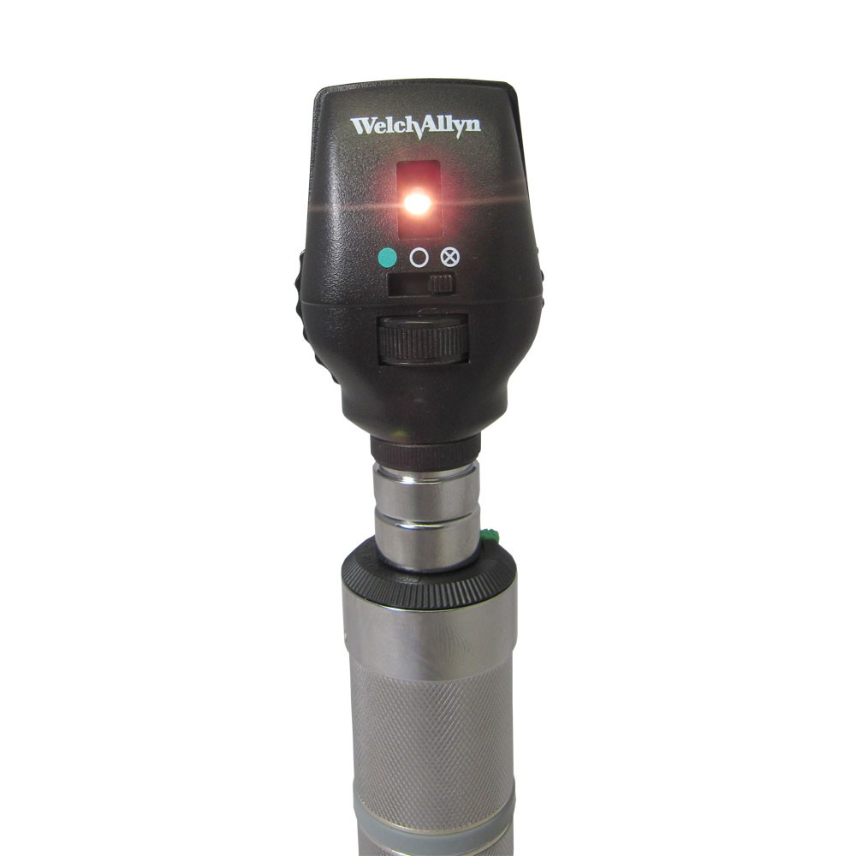
QUIZ !!!
24. Can you name the device?
a. Viscualmoscope
b. Opthalmoscan
c. Opthalmoscope
d. Eye vision tester

Slide 26
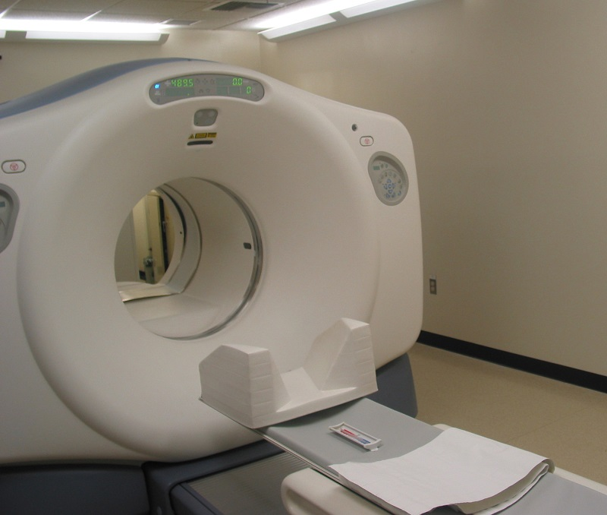
QUIZ !!!
25. Can you name the device?
a. Ultrasound machine
b. Magnetic resonance Imaging
c. CT Scanner
d. Infrared therapy machine

Slide 27


